Slide 1
Mechanisms for Predecessor Rain Events Ahead of Tropical Cyclones
Benjamin J. Moore, Lance F. Bosart, and Daniel Keyser
Department of Atmospheric and Environmental Sciences,
University at Albany/SUNY, Albany, NY
Michael L. Jurewicz, Sr.
NOAA/NWS, Binghamton, NY
NOAA/NWS Eastern Region Flash Flood Conference, Wilkes-Barre, PA
2−4 June 2010

Slide 2
Outline
Overview of a PRE
PRE stratification scheme
PRE-relative composite analysis
PRE associated with TC Ernesto (2006)
Concluding remarks

Slide 3
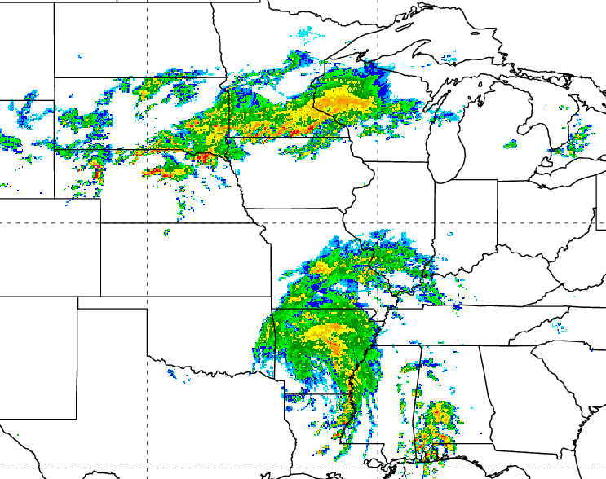
Predecessor Rain Events Ahead of Tropical Cyclones
Defined by Cote (2007) as distinct mesoscale regions of heavy rainfall [~100 mm (24 h)⁻¹] ~1000 km downstream of landfalling and recurving tropical cyclones (TCs)
Develop as a poleward stream of moisture from a TC interacts with a region of forcing for ascent
Pose a substantial flash-flooding risk due to:
Prolonged, high precipitation rates
High precipitation efficiencies
PRE ahead of TC Rita
06Z 25 Sep 2005
PRE

Slide 4
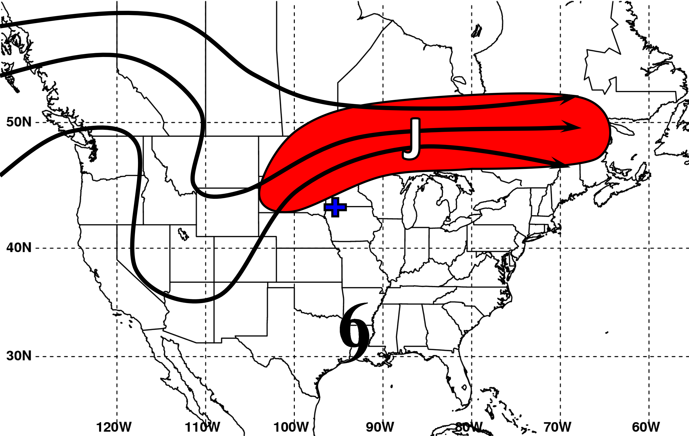
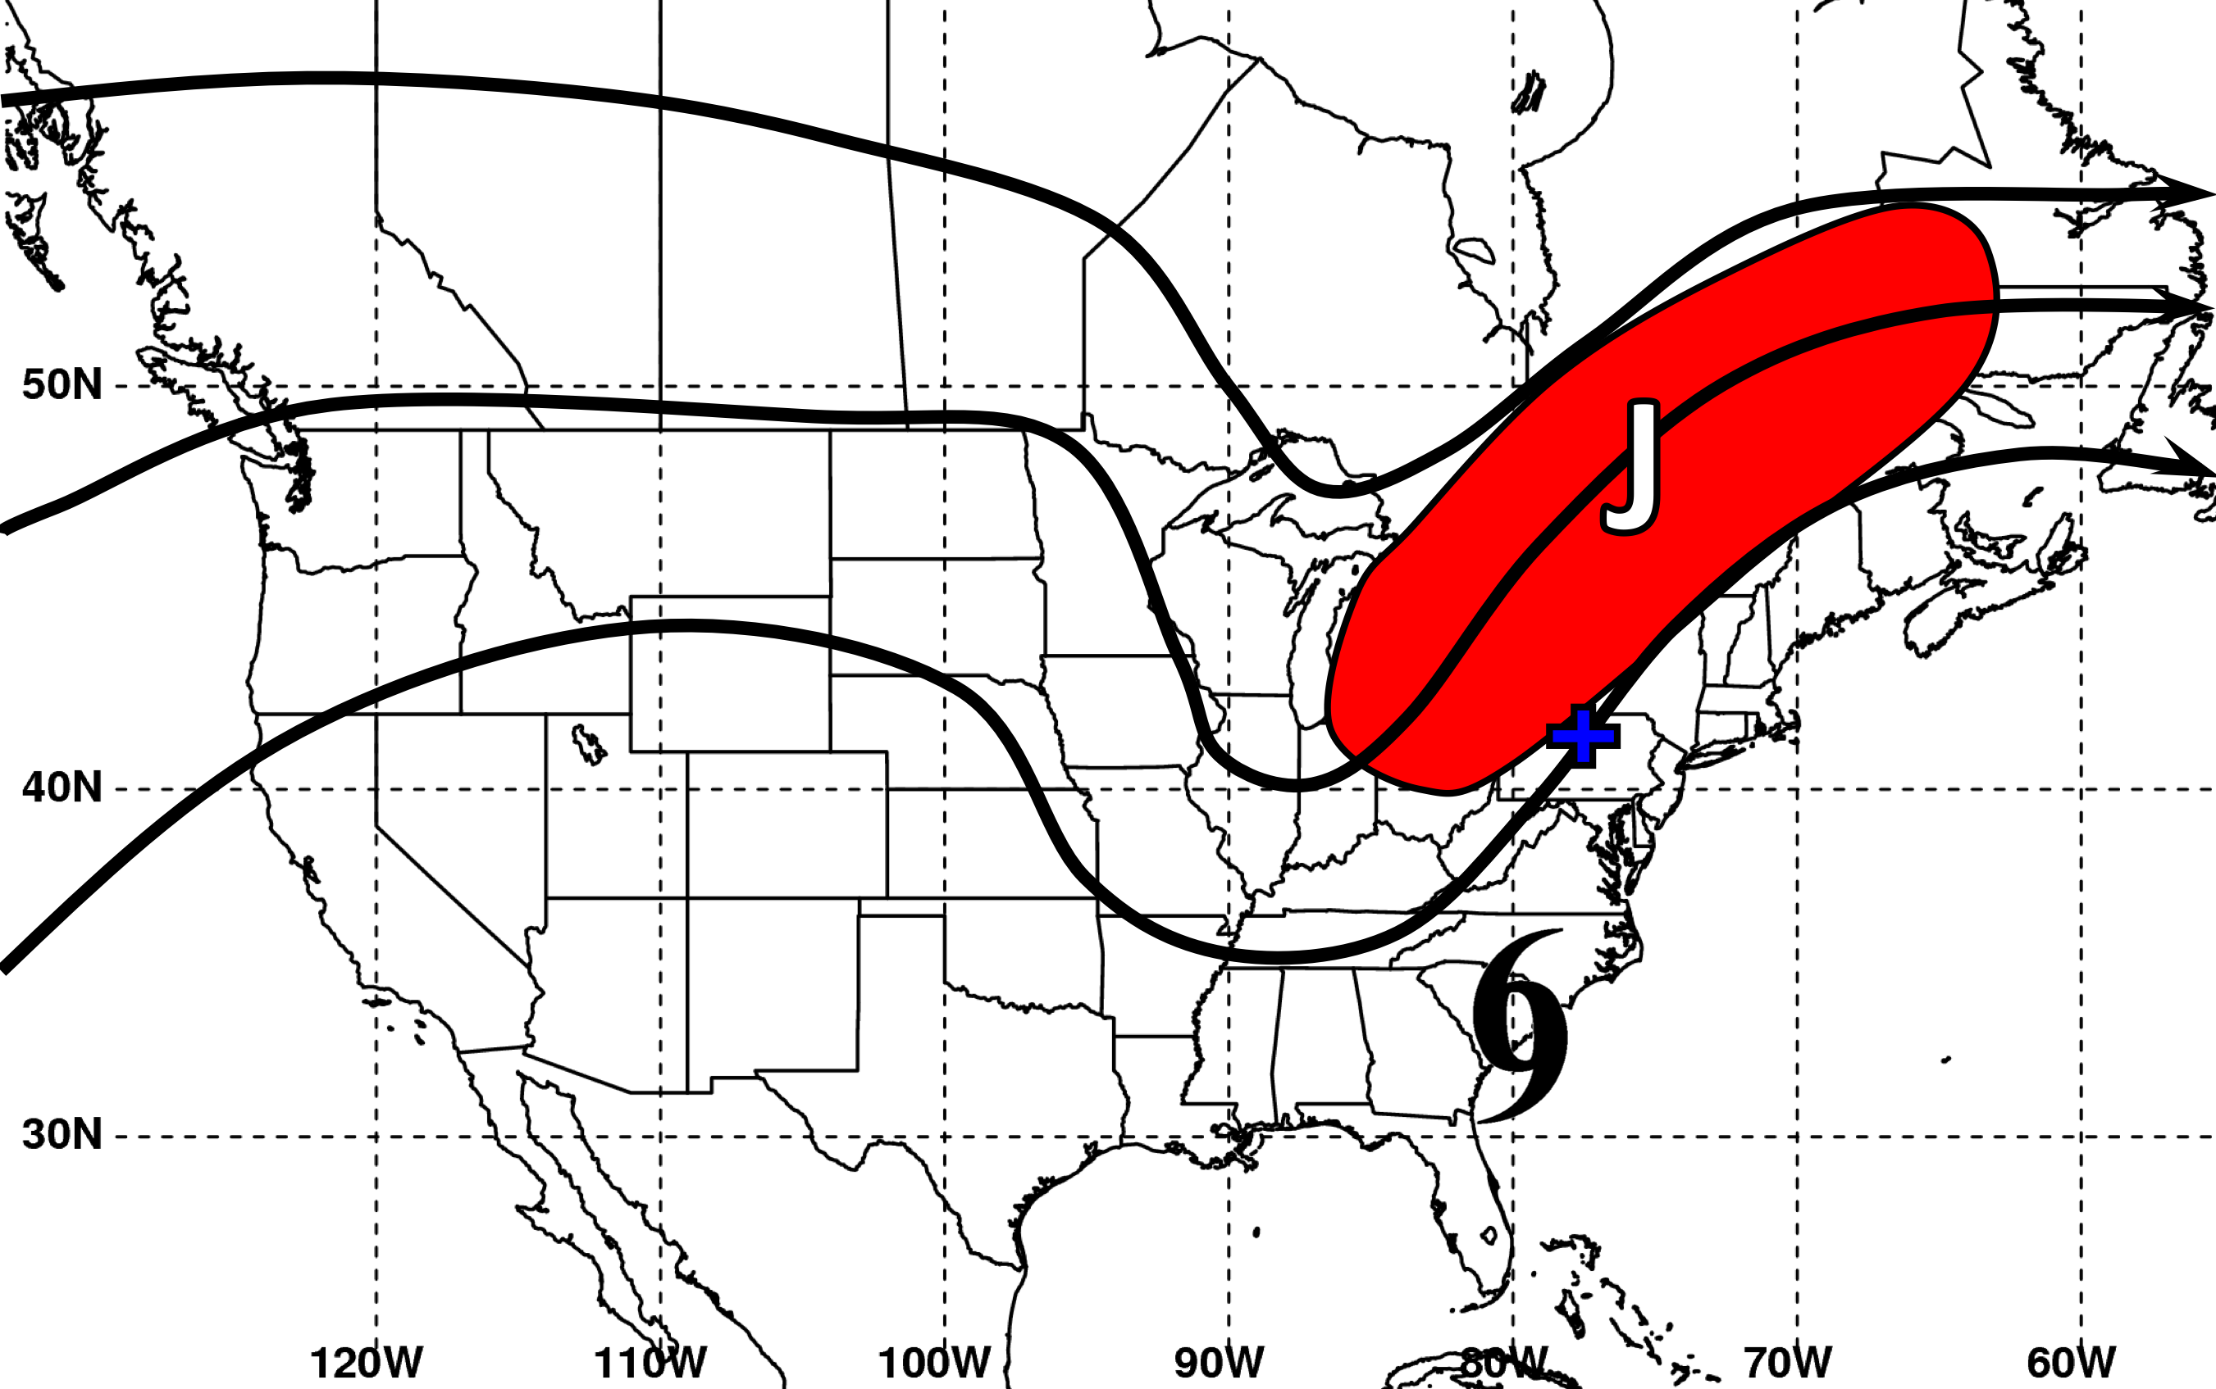
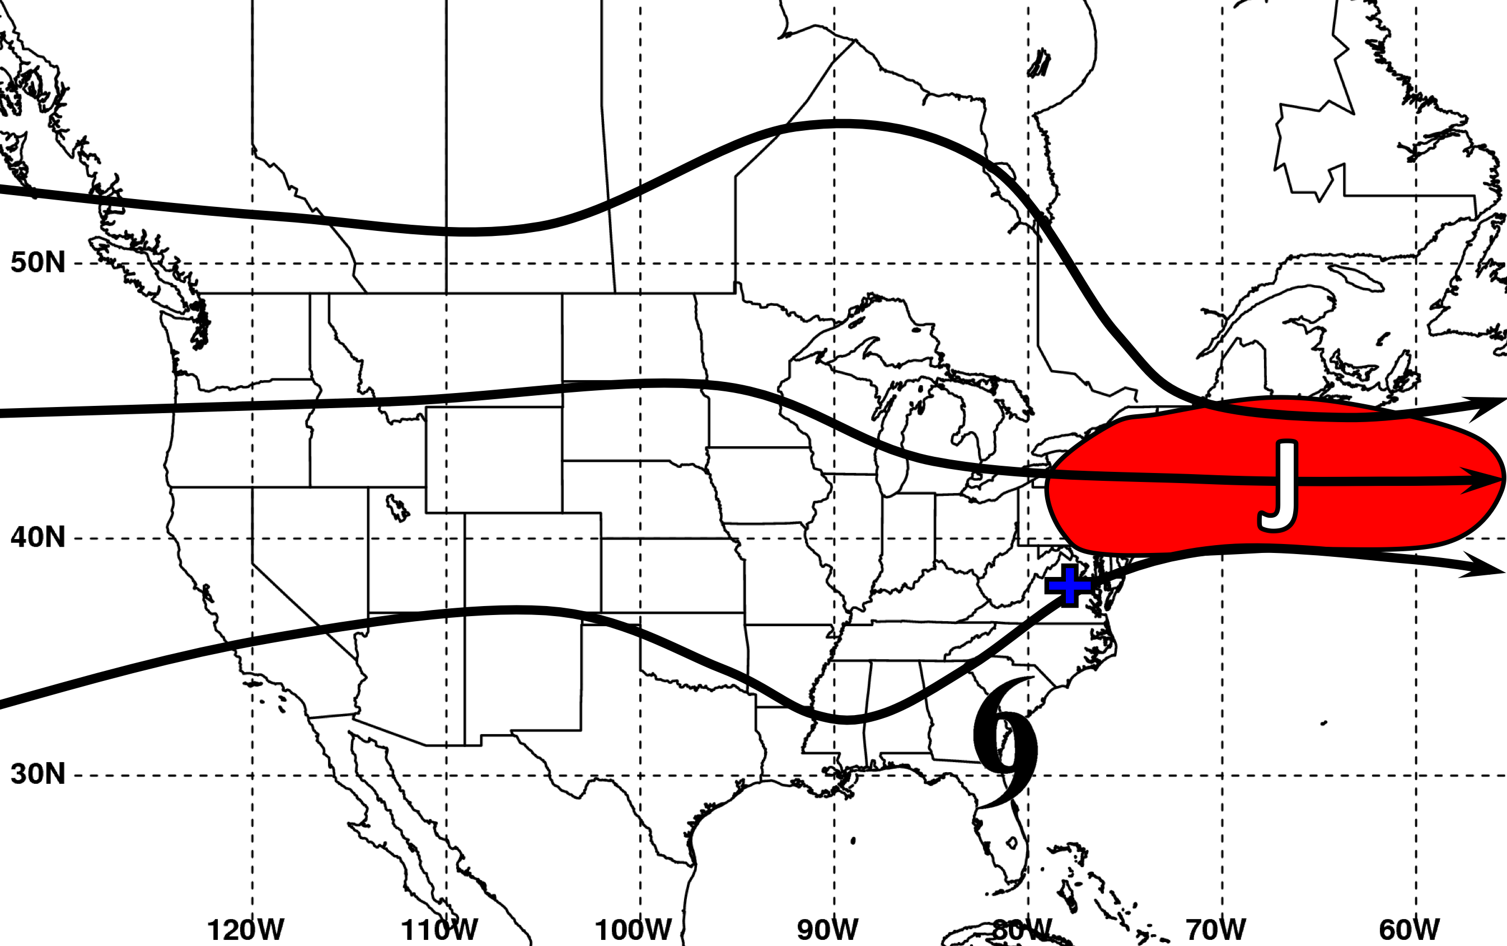
PRE Stratification Scheme
“Jet in Ridge”
“Southwesterly Jet”
“Downstream Confluence”

Slide 5
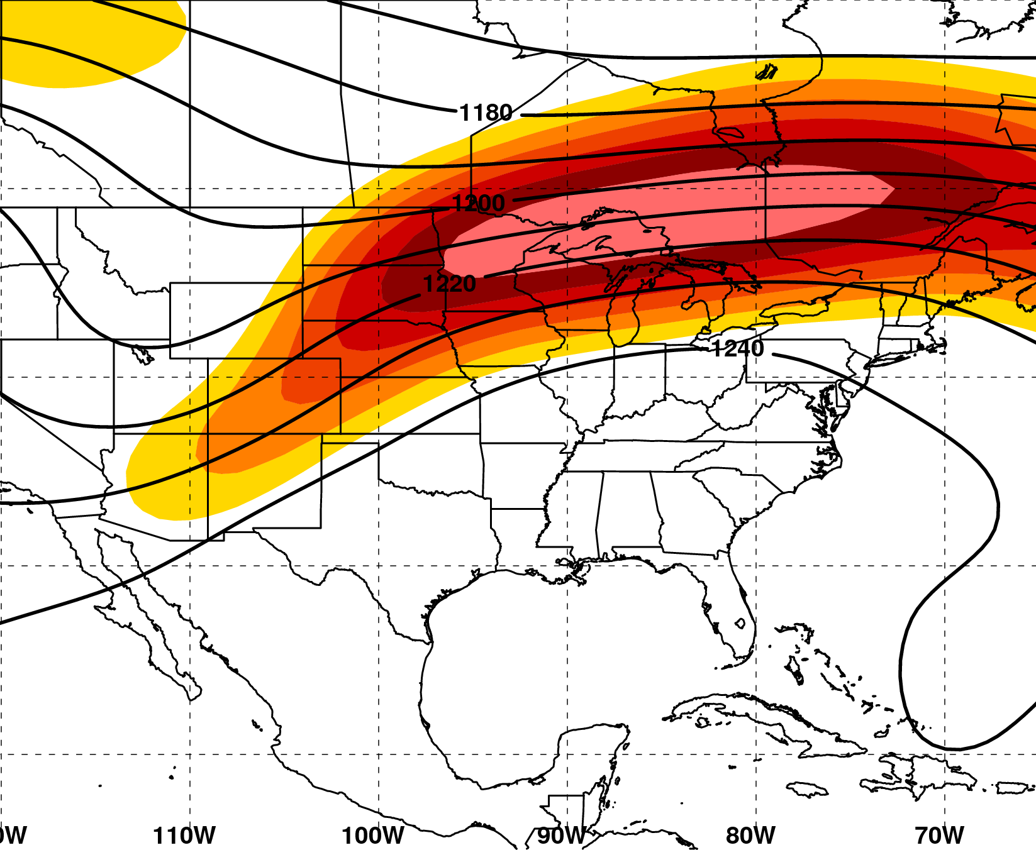
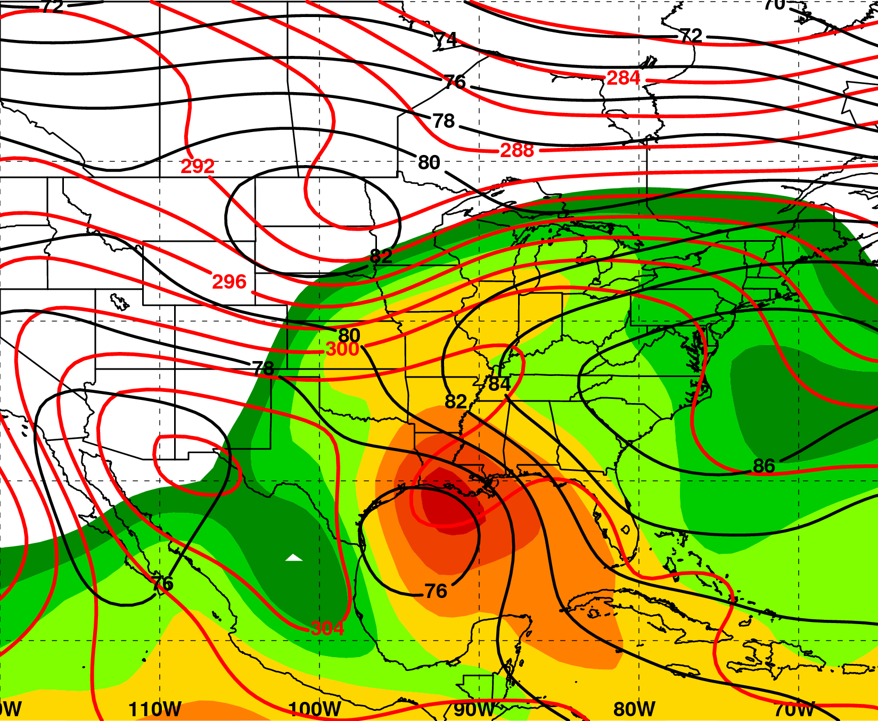
PRE-Relative Composites
N = 9
“Jet in ridge” Category
200 hPa
T−0
925 hPa
H
L
m s⁻¹
mm
200 hPa Z (dam, black),
wind speed (>25 m s⁻¹, shaded)
925 hPa Z (dam, black), θ (K, red), total precipitable water (>25 mm, shaded)
2.5º NCEP–NCAR Reanalysis

Slide 6
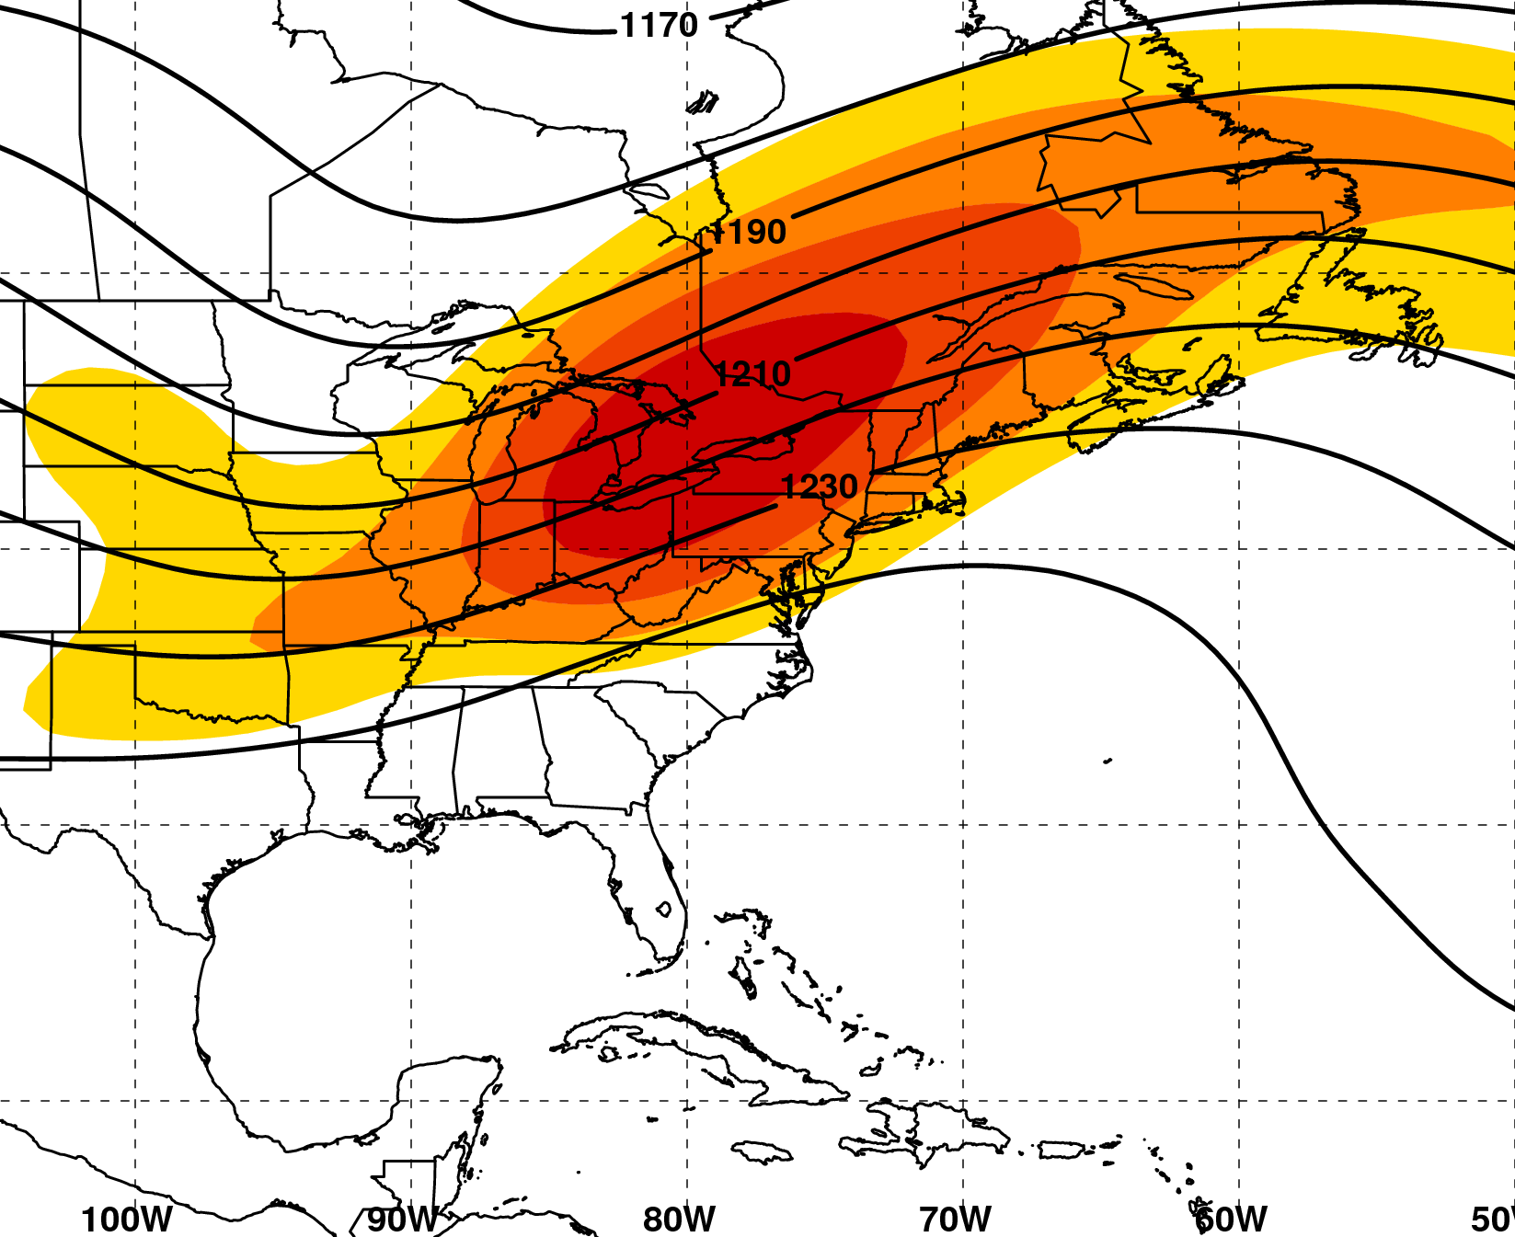
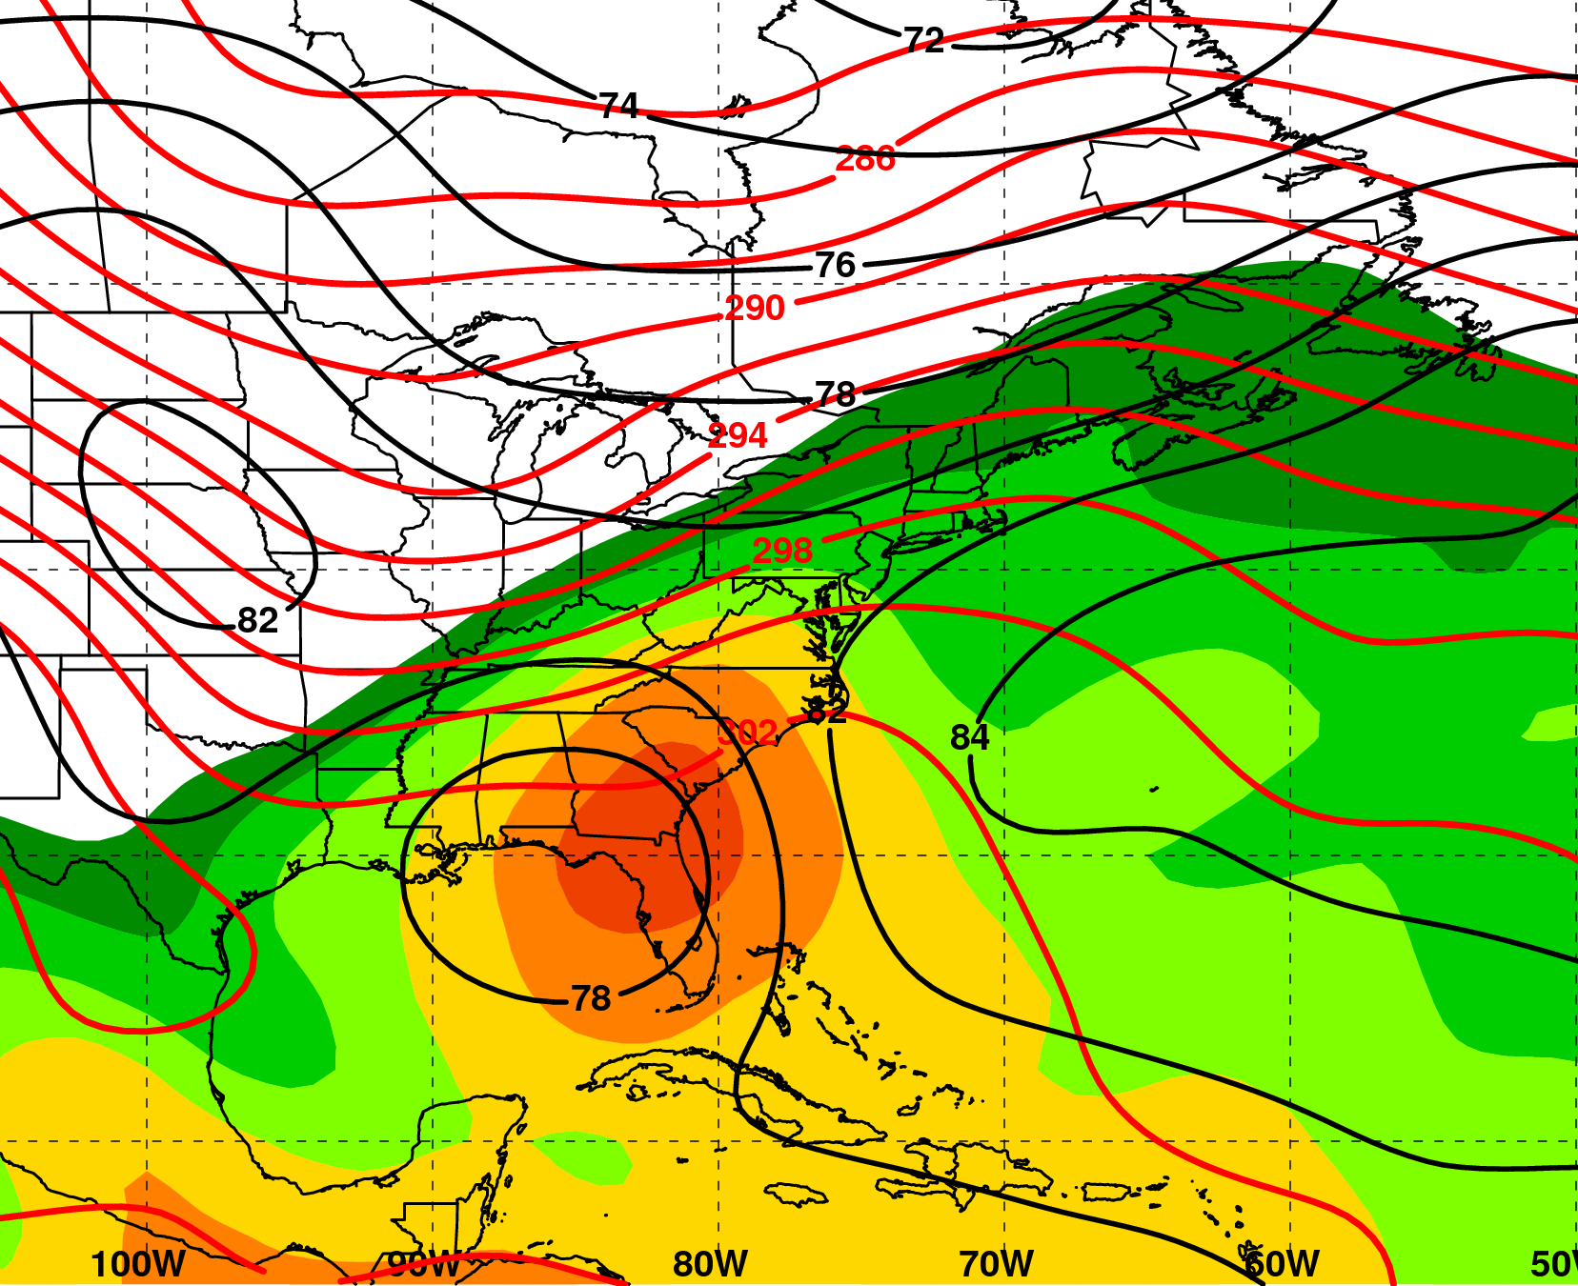
PRE-Relative Composites
N = 15
“Southwesterly jet” Category
200 hPa
T−0
925 hPa
H
m s⁻¹
mm
200 hPa Z (dam, black),
wind speed (>25 m s⁻¹, shaded)
925 hPa Z (dam, black), θ (K, red), total precipitable water (>25 mm, shaded)
2.5º NCEP–NCAR Reanalysis
2.5º NCEP–NCAR Renalysis

Slide 7
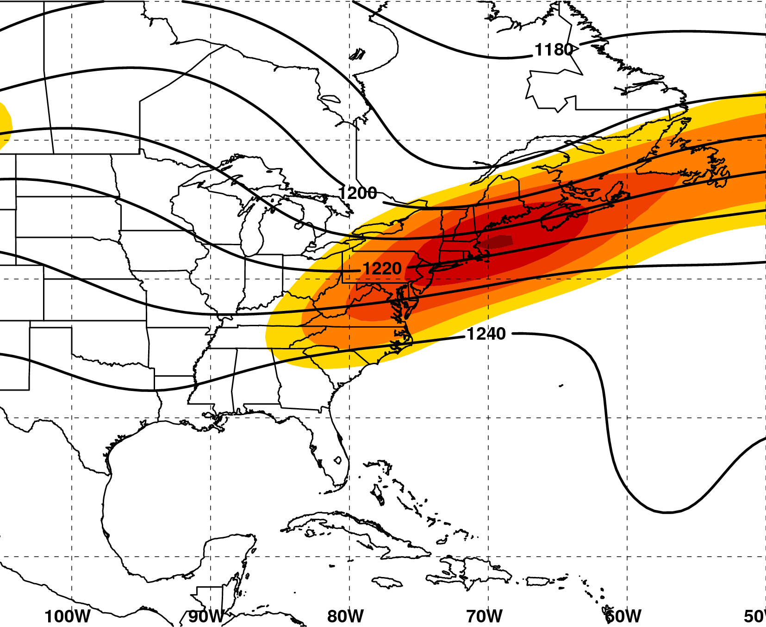
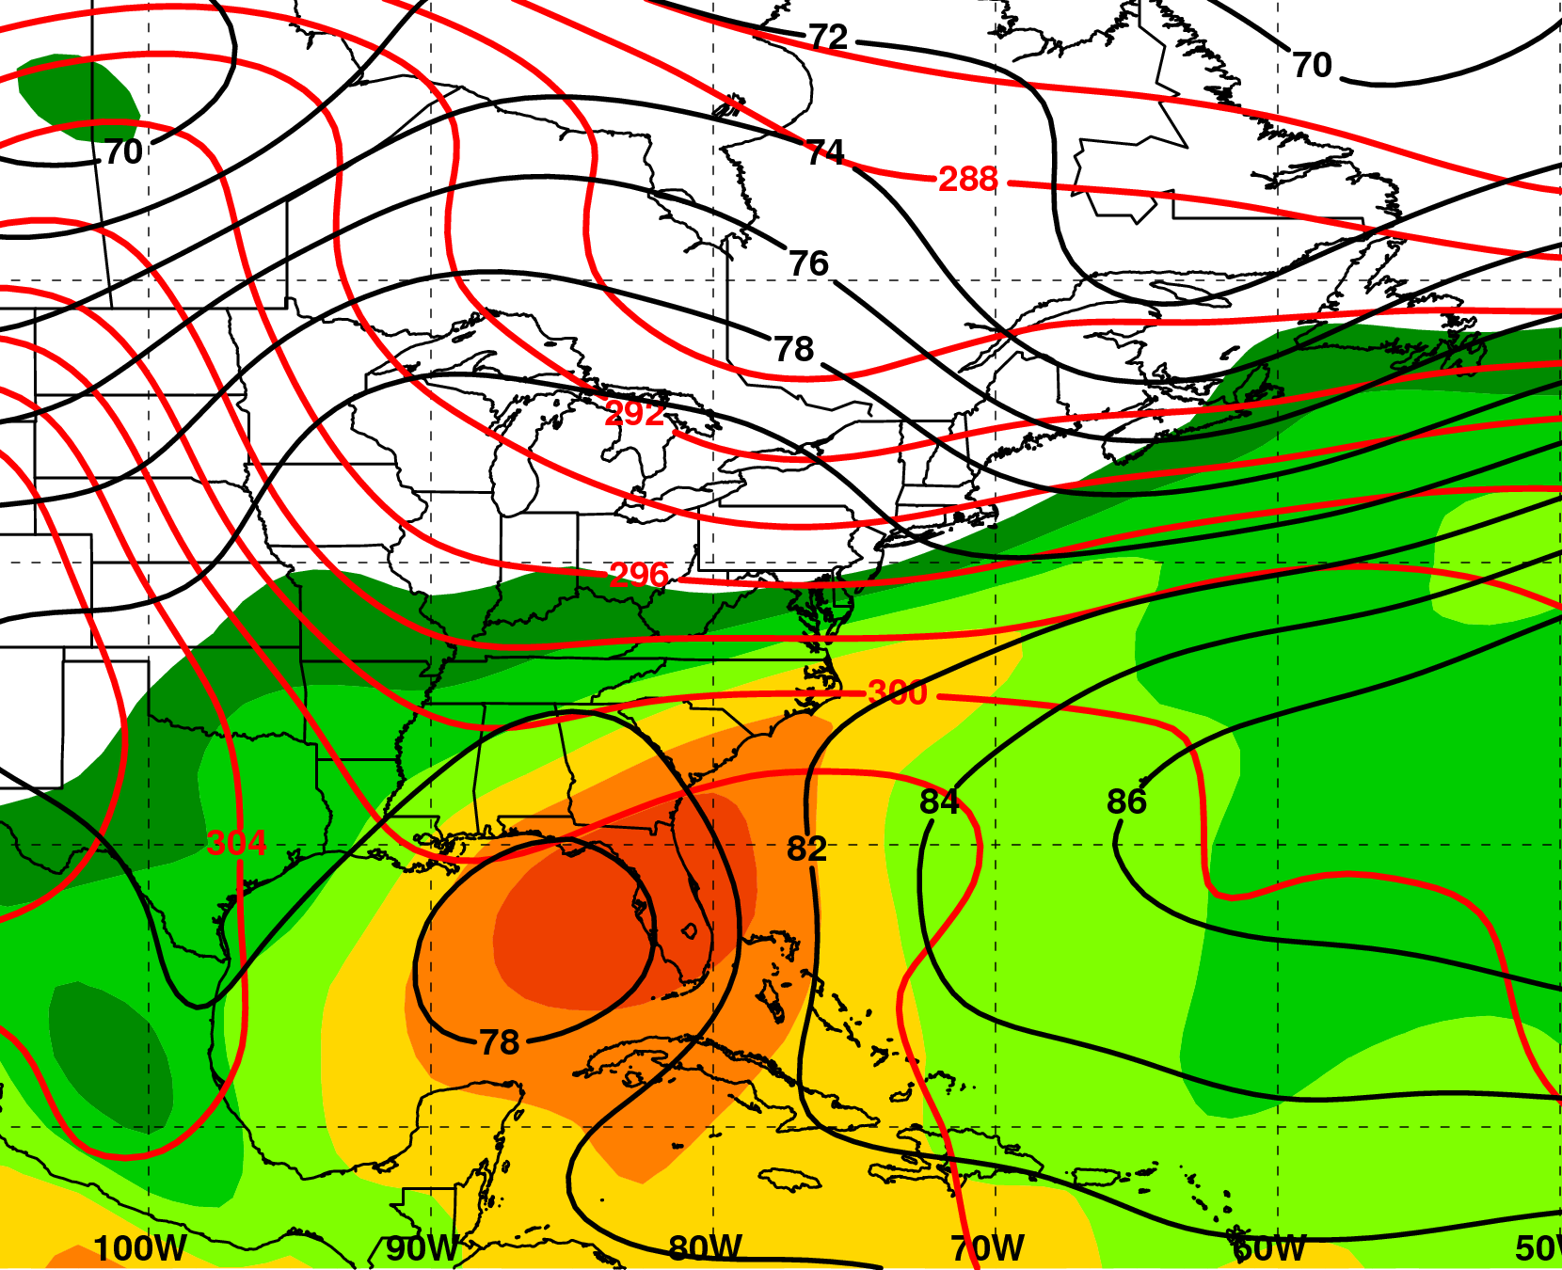
PRE-Relative Composites
N = 9
“Downstream confluence” Category
200 hPa
T−0
925 hPa
H
m s⁻¹
mm
200 hPa Z (dam, black),
wind speed (>25 m s⁻¹, shaded)
925 hPa Z (dam, black), θ (K, red), total precipitable water (>25 mm, shaded)
2.5º NCEP–NCAR Reanalysis

Slide 8
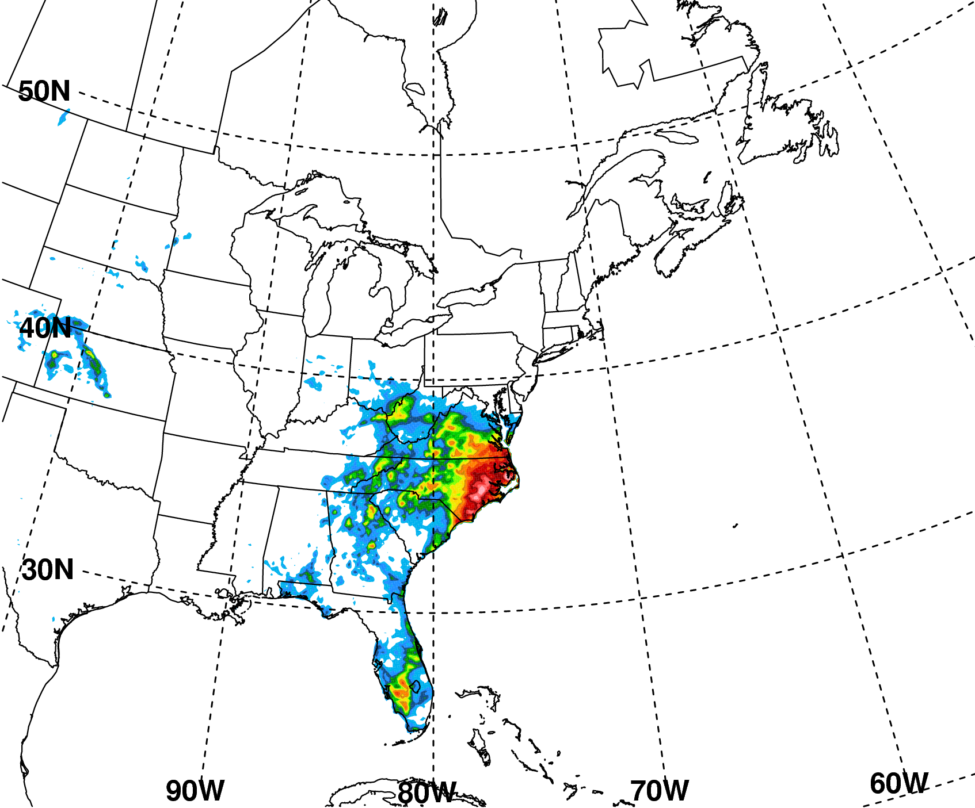
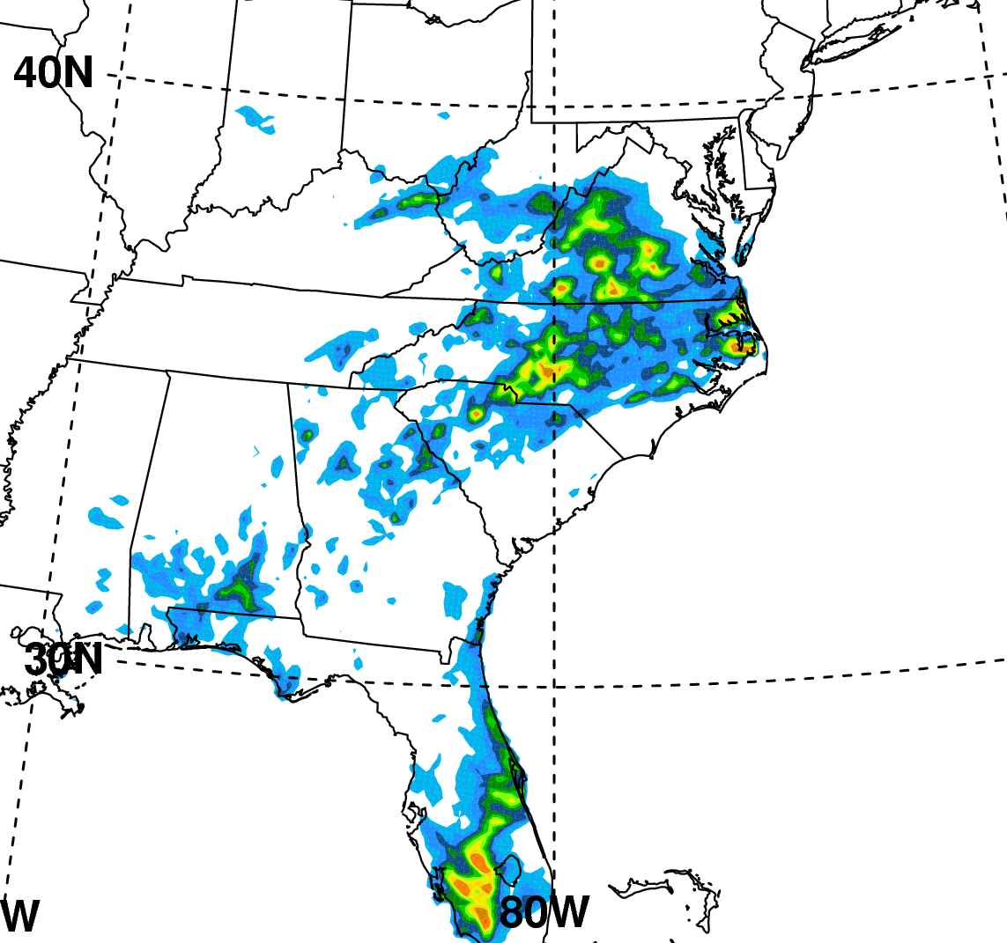
“Downstream Confluence” PRE associated with TC Ernesto 30–31 Aug 2006
PRE
mm
3
1200 UTC 30 −
1200 UTC 31 Aug
2
1
31
Ernesto Track
30
00 UTC
12 UTC
NPVU QPE for 1200 UTC 30 Aug − 1200 UTC 1 Sep

Slide 9
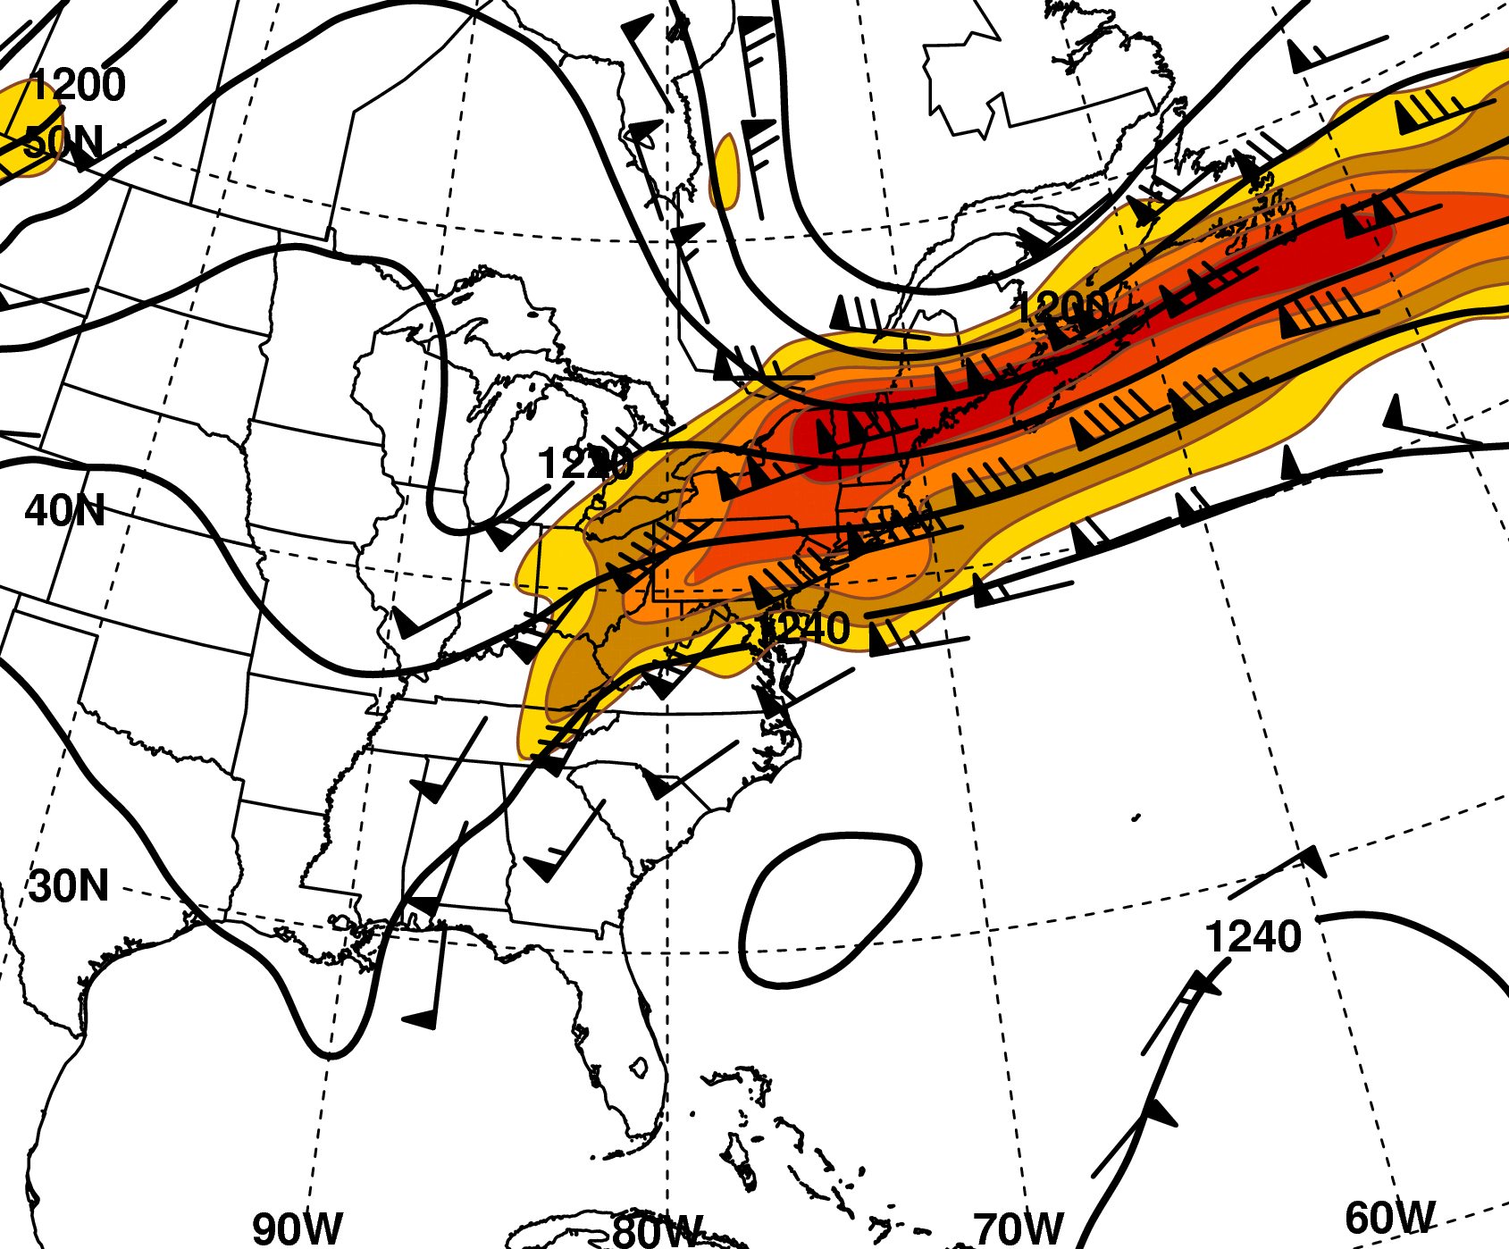
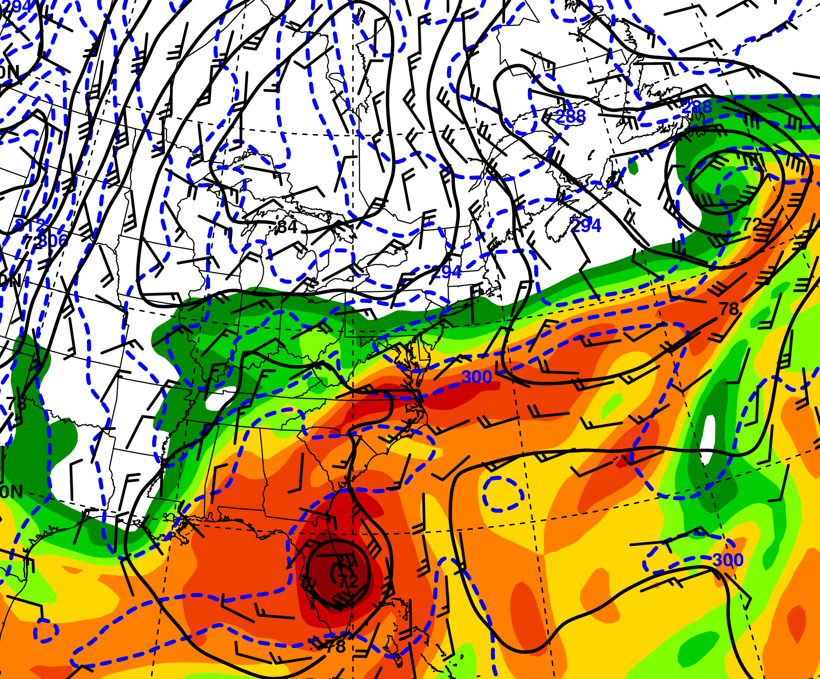
Synoptic Environment
0000 UTC 31 Aug 2006
200 hPa
925 hPa
mm
200 hPa Z (dam, black),
wind barbs (≥25 m s⁻¹, barbs),
wind speed (>35 m s⁻¹, shaded)
925 hPa Z (dam, black),
θ (K, blue), wind barbs (≥10 m s⁻¹, barbs) total precipitable water (>30 mm, shaded)
1º GFS Analysis

Slide 10
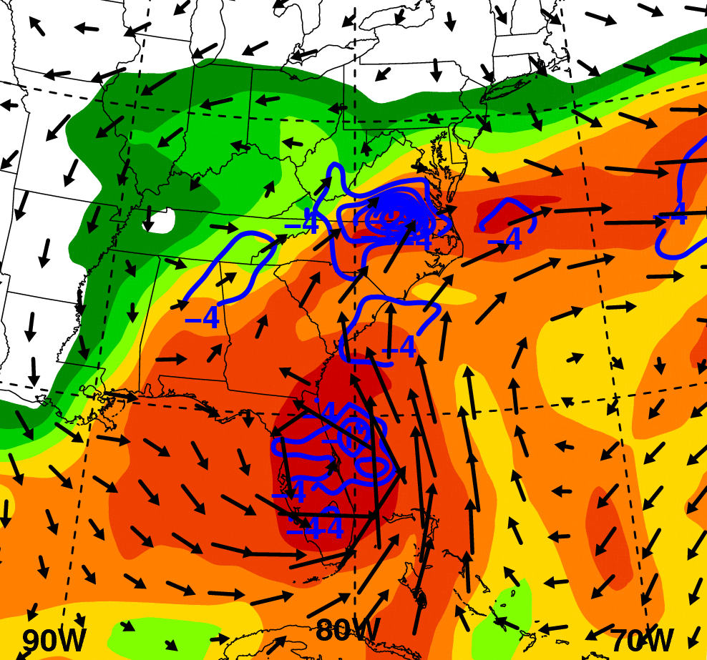
Moisture Supply from Ernesto
0000 UTC 31 Aug
1º GFS Analysis
Total precipitable water (mm, shaded), 1000−300 hPa vertically integrated WV flux vectors ( kg m⁻¹ s⁻¹), WV flux convergence (10⁻³ kg m⁻² s⁻¹, blue),

Slide 11
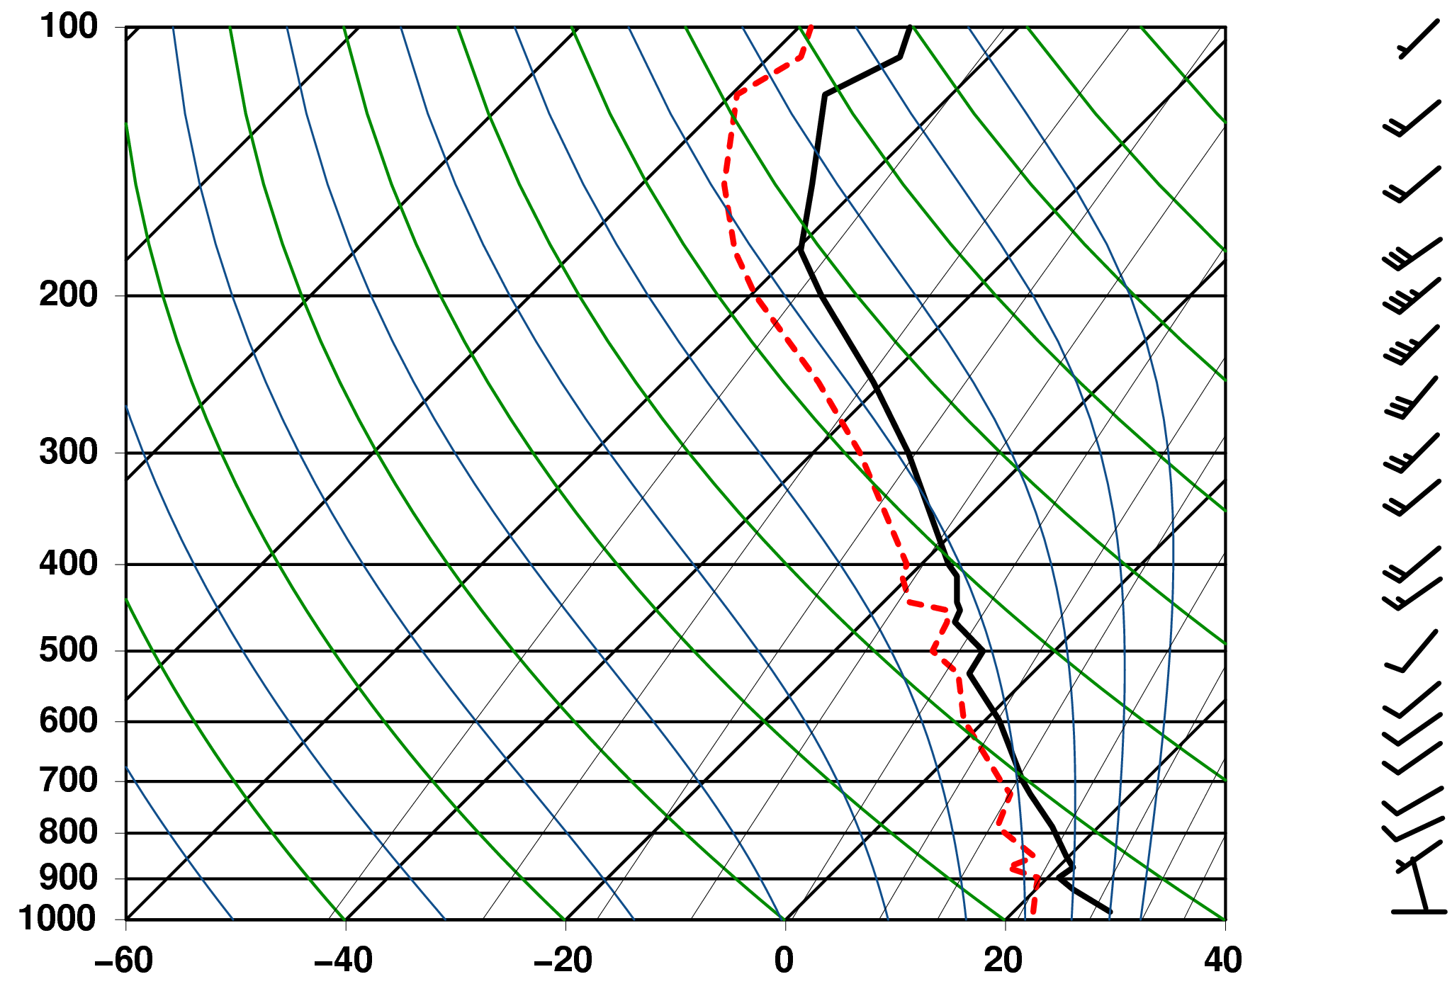
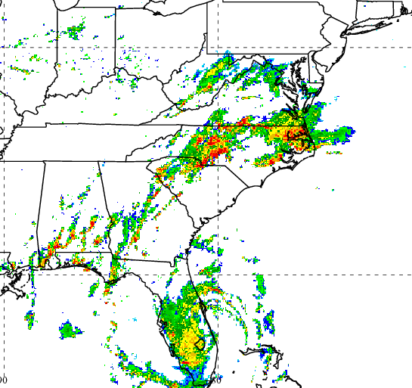
Greensboro Sounding
1800 UTC 30 Aug
CAPE = 1752 J kg⁻¹
PWAT = 53.86 mm
Weak, unidirectional shear favors echo “training”
Pressure (hPa)
Parcel lifted
from the surface
2200 UTC 30 Aug
GSO

Slide 12
Low-level Evolution
1800 UTC 30 Aug
20 km RUC Analysis
WSI NOWRAD reflectivity (dBZ); 10 m wind barbs (m s⁻¹), 2 m θ (K, red)

Slide 13
Low-level Evolution
2100 UTC 30 Aug
20 km RUC Analysis
WSI NOWRAD reflectivity (dBZ); 10 m wind barbs (m s⁻¹), 2 m θ (K, red)

Slide 14
Low-level Evolution
0000 UTC 31 Aug
20 km RUC Analysis
WSI NOWRAD reflectivity (dBZ); 10 m wind barbs (m s⁻¹), 2 m θ (K, red)

Slide 15
Low-level Evolution
0300 UTC 31 Aug
20 km RUC Analysis
WSI NOWRAD reflectivity (dBZ); 10 m wind barbs (m s⁻¹), 2 m θ (K, red)

Slide 16
Low-level Evolution
0600 UTC 31 Aug
20 km RUC Analysis
WSI NOWRAD reflectivity (dBZ); 10 m wind barbs (m s⁻¹), 2 m θ (K, red)

Slide 17
Low-level Evolution
0900 UTC 31 Aug
20 km RUC Analysis
WSI NOWRAD reflectivity (dBZ); 10 m wind barbs (m s⁻¹), 2 m θ (K, red)

Slide 18
Low-level Evolution
1200 UTC 31 Aug
20 km RUC Analysis
WSI NOWRAD reflectivity (dBZ); 10 m wind barbs (m s⁻¹), 2 m θ (K, red)

Slide 19
Low-level Evolution
1800 UTC 31 Aug
20 km RUC Analysis
WSI NOWRAD reflectivity (dBZ); 10 m wind barbs (m s⁻¹), 2 m θ (K, red)

Slide 20
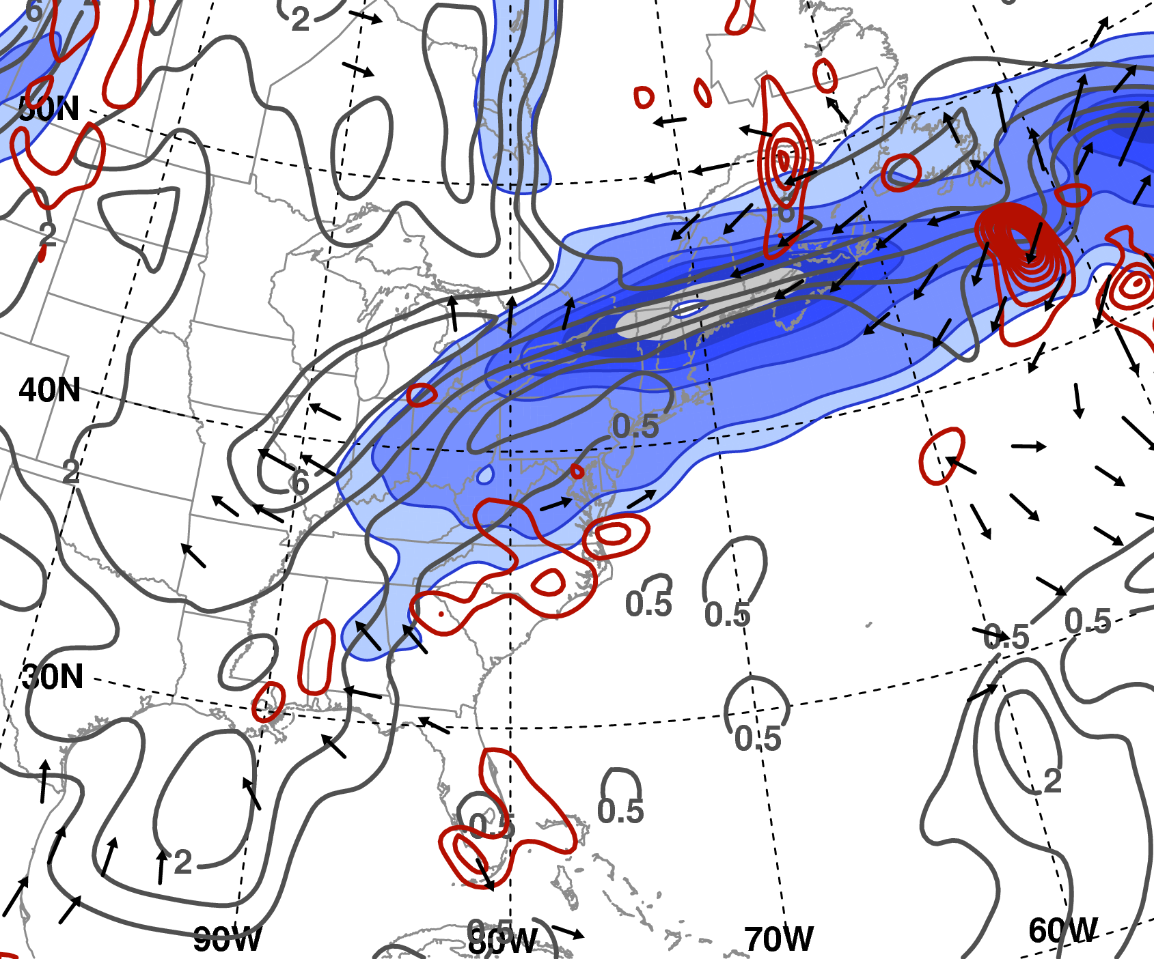
Upper-level Flow Evolution
1800 UTC 30 Aug
1º GFS Analysis
200 hPa potential vorticity (PVU, gray), irrotational wind (m s⁻¹), wind speed (m s⁻¹, shaded); 700 hPa ascent (10⁻³ hPa s⁻¹, red)

Slide 21
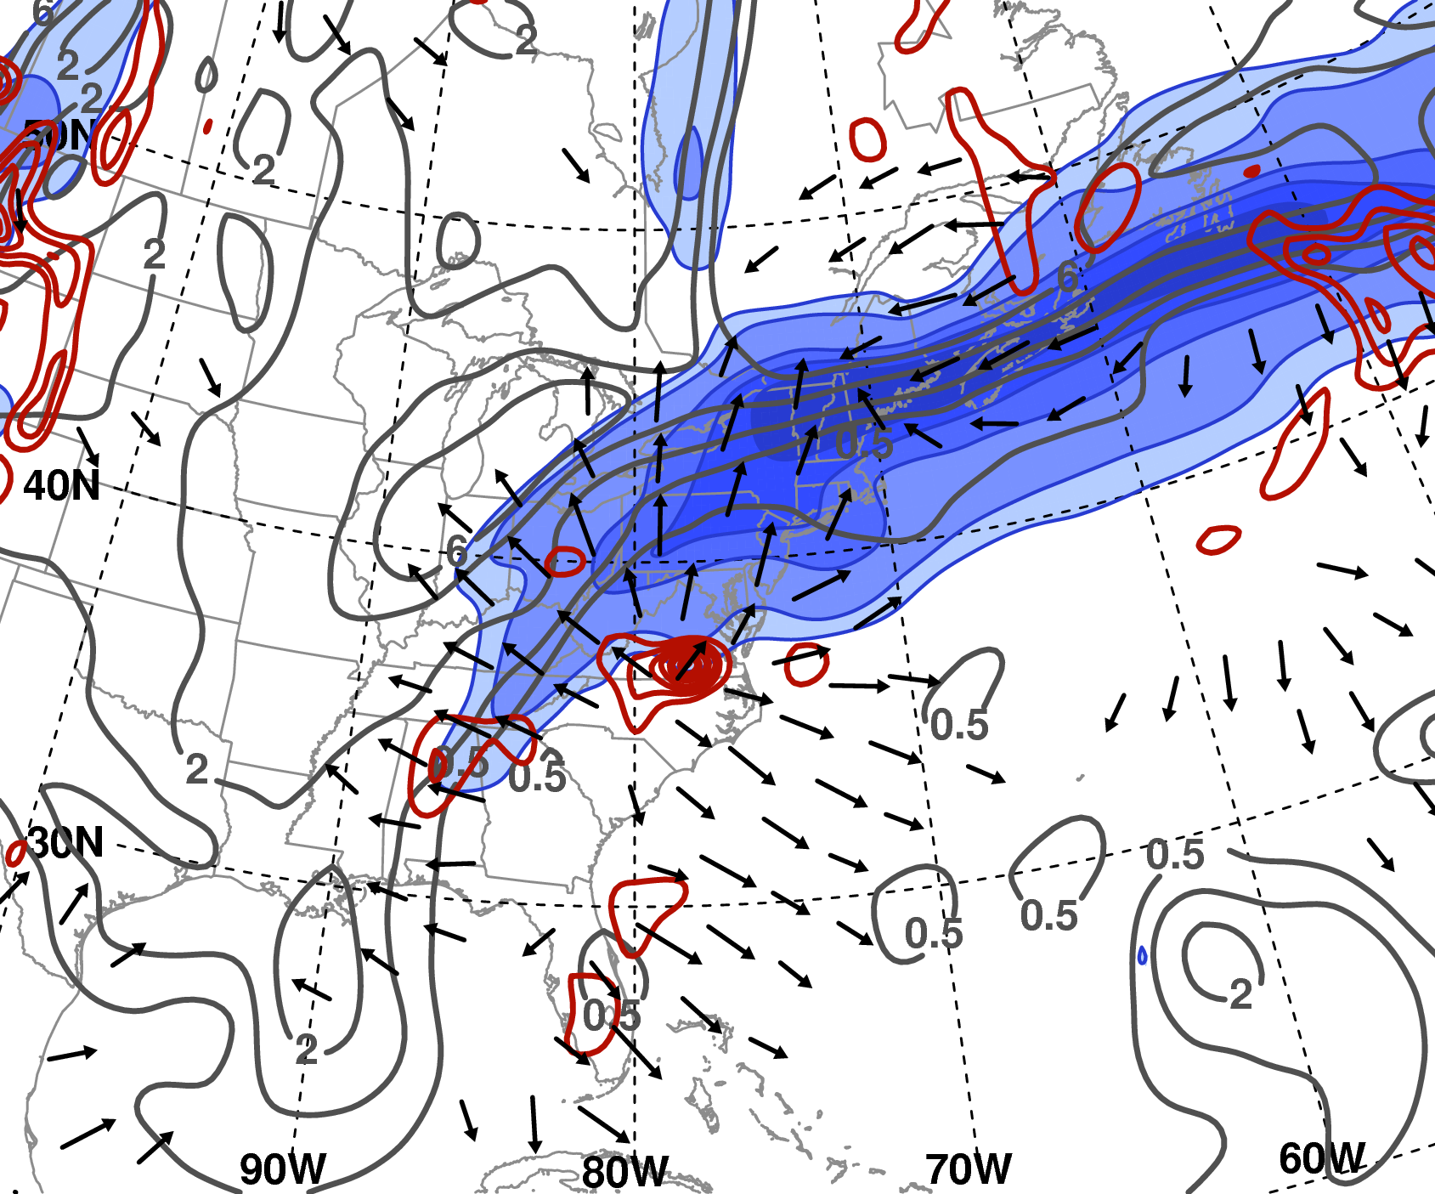
Upper-level Flow Evolution
0000 UTC 31 Aug
1º GFS Analysis
200 hPa potential vorticity (PVU, gray), irrotational wind (m s⁻¹), wind speed (m s⁻¹, shaded); 700 hPa ascent (10⁻³ hPa s⁻¹, red)

Slide 22
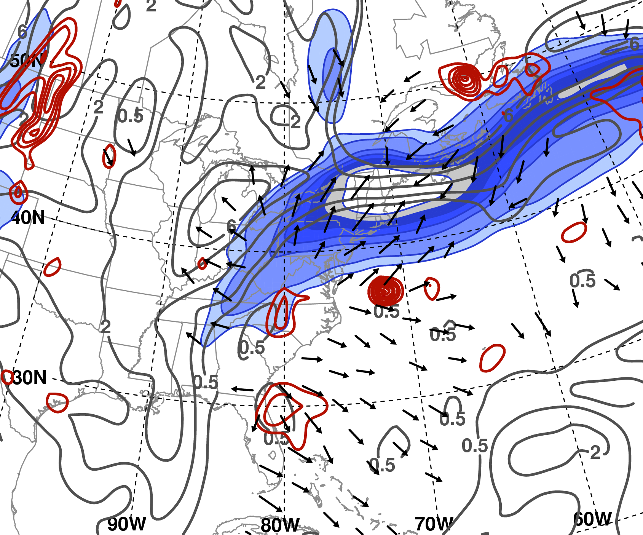
Upper-level Flow Evolution
0600 UTC 31 Aug
1º GFS Analysis
200 hPa potential vorticity (PVU, gray), irrotational wind (m s⁻¹), wind speed (m s⁻¹, shaded); 700 hPa ascent (10⁻³ hPa s⁻¹, red)

Slide 23
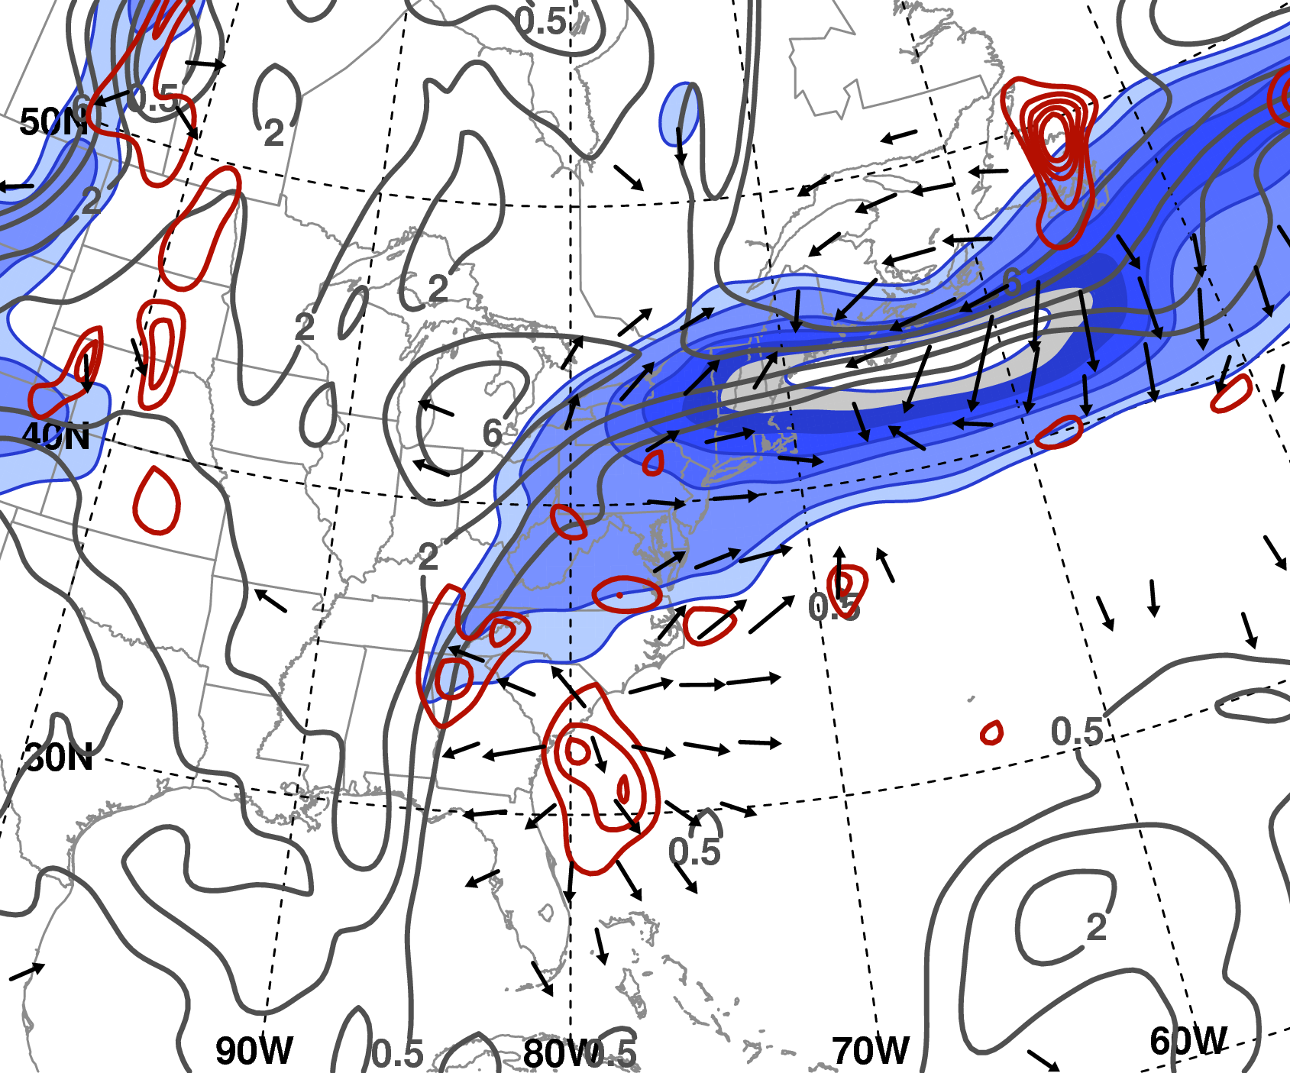
Upper-level Flow Evolution
1200 UTC 31 Aug
1º GFS Analysis
200 hPa potential vorticity (PVU, gray), irrotational wind (m s⁻¹), wind speed (m s⁻¹, shaded); 700 hPa ascent (10⁻³ hPa s⁻¹, red)

Slide 24
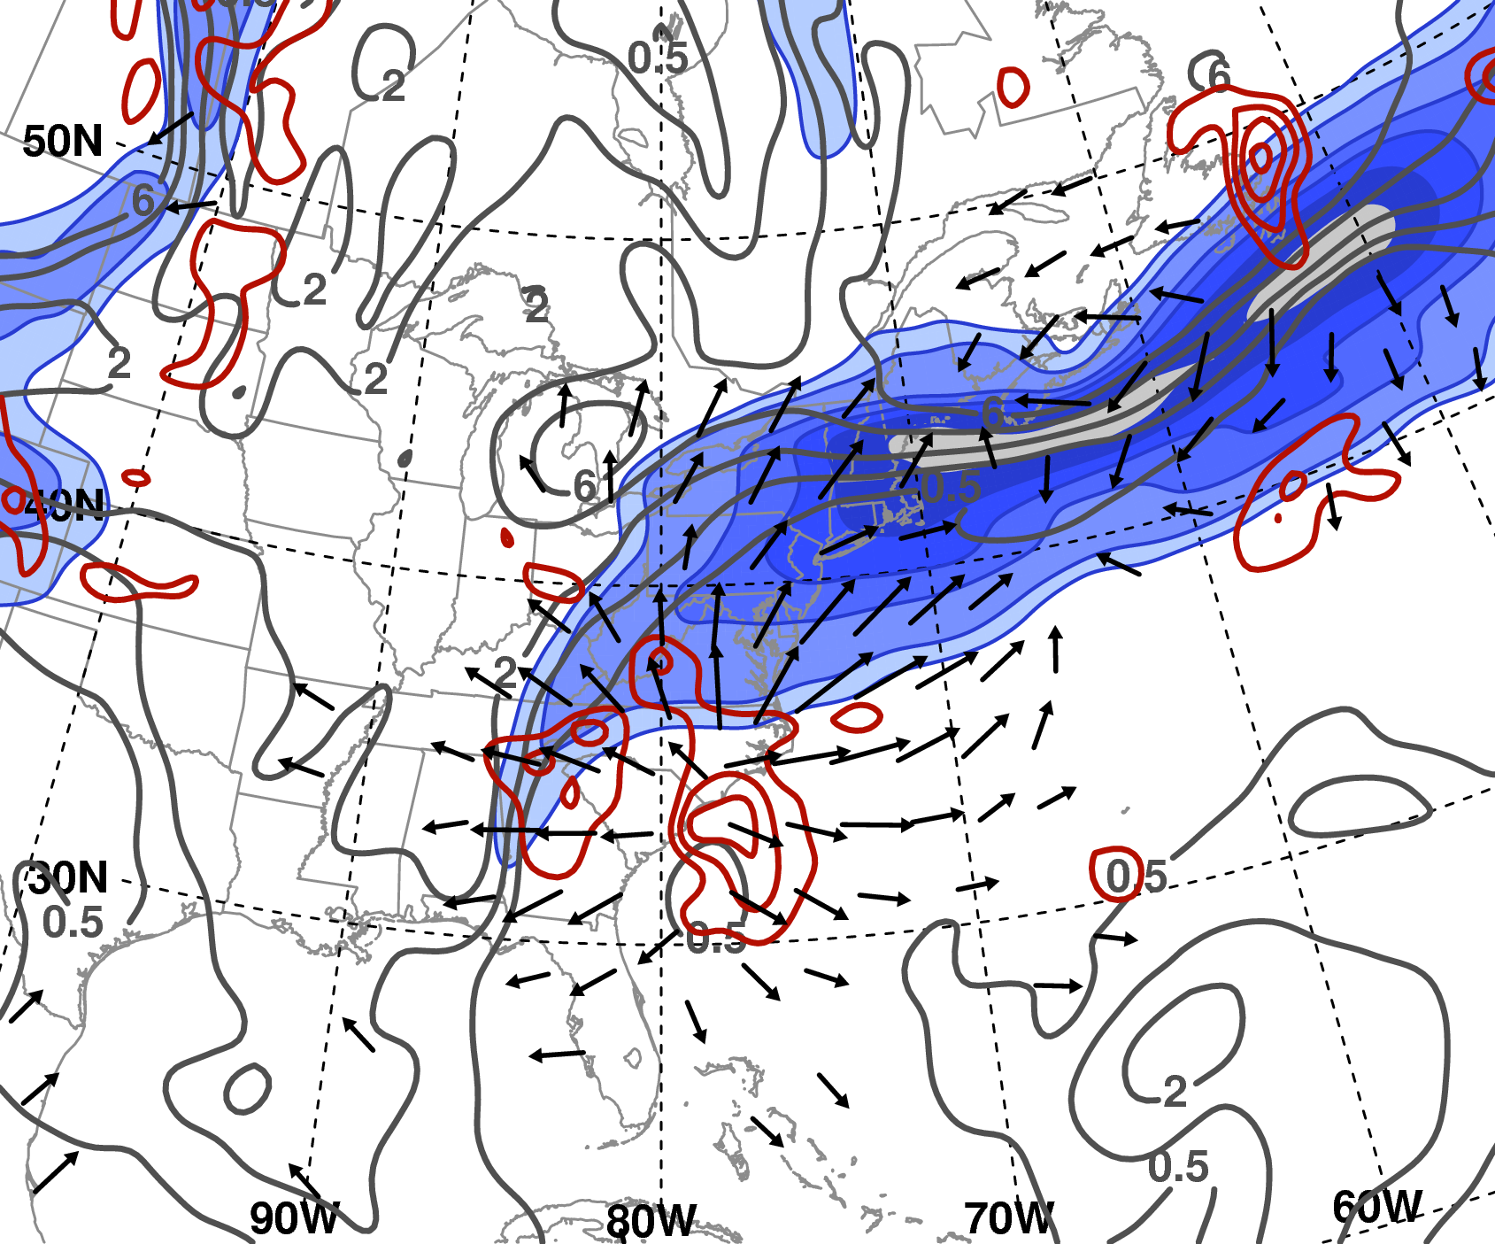
Upper-level Flow Evolution
1800 UTC 31 Aug
1º GFS Analysis
200 hPa potential vorticity (PVU, gray), irrotational wind (m s⁻¹), wind speed (m s⁻¹, shaded); 700 hPa ascent (10⁻³ hPa s⁻¹, red)

Slide 25
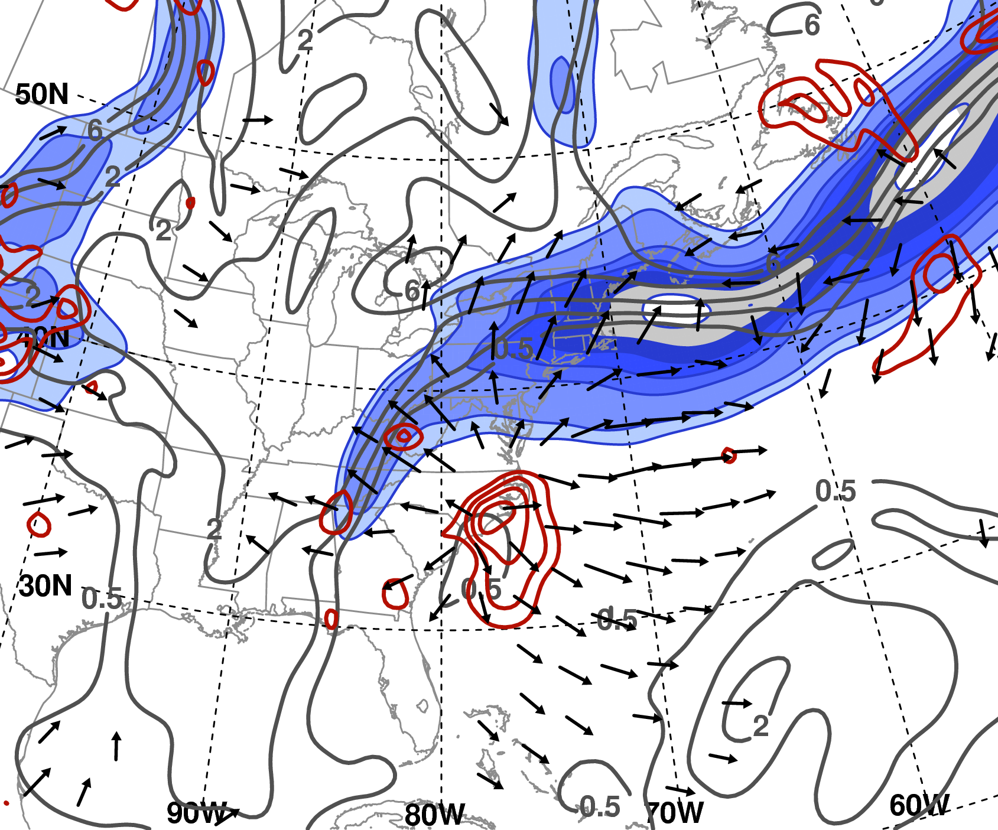
Upper-level Flow Evolution
0000 UTC 1 Sep
1º GFS Analysis
200 hPa potential vorticity (PVU, gray), irrotational wind (m s⁻¹), wind speed (m s⁻¹, shaded); 700 hPa ascent (10⁻³ hPa s⁻¹, red)

Slide 26
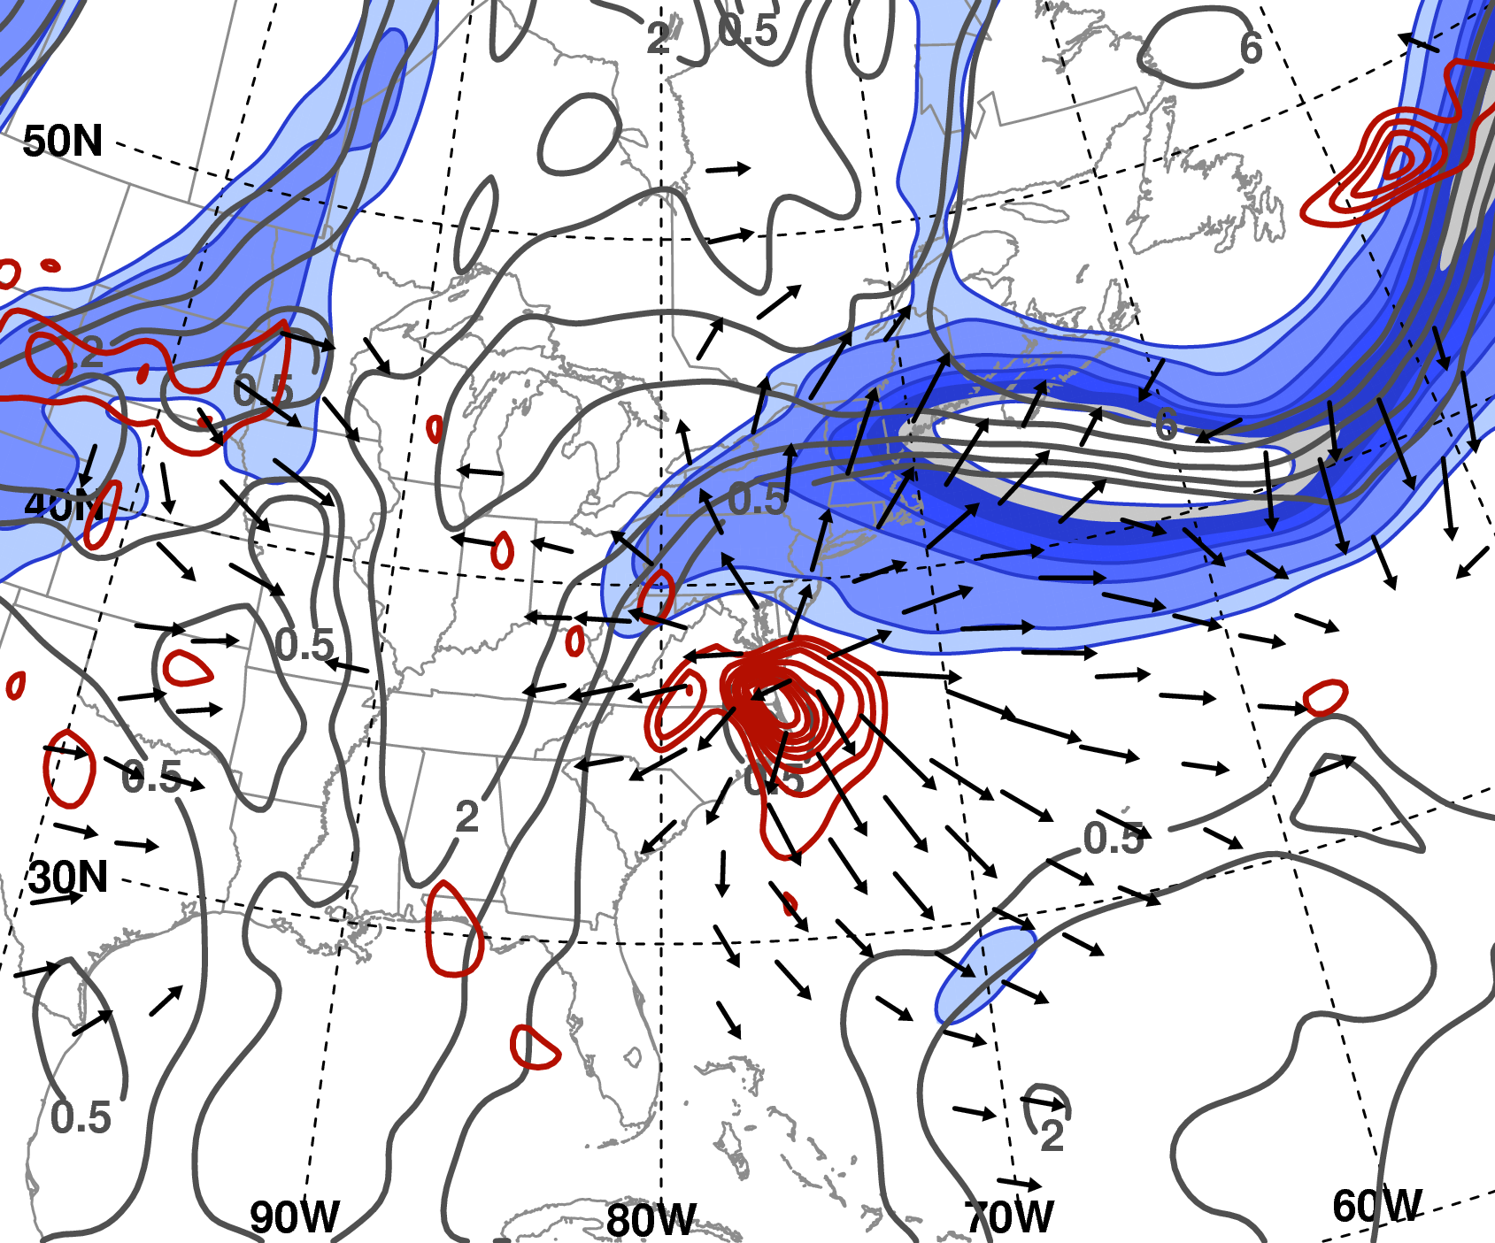
Upper-level Flow Evolution
1200 UTC 1 Sep
1º GFS Analysis
200 hPa potential vorticity (PVU, gray), irrotational wind (m s⁻¹), wind speed (m s⁻¹, shaded); 700 hPa ascent (10⁻³ hPa s⁻¹, red)

Slide 27
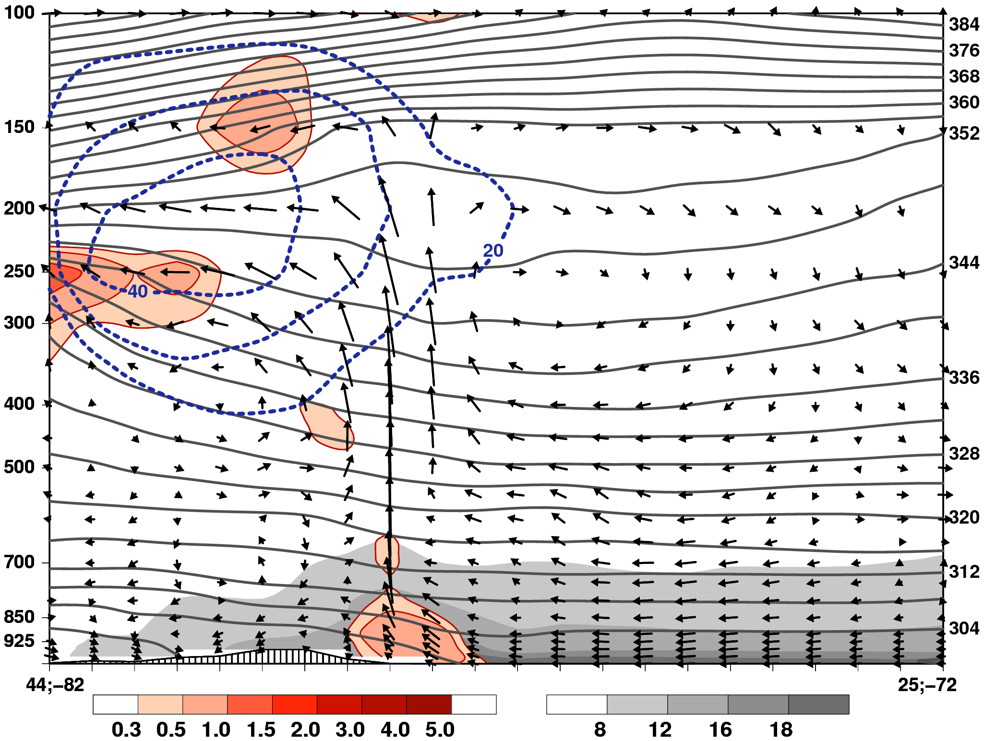
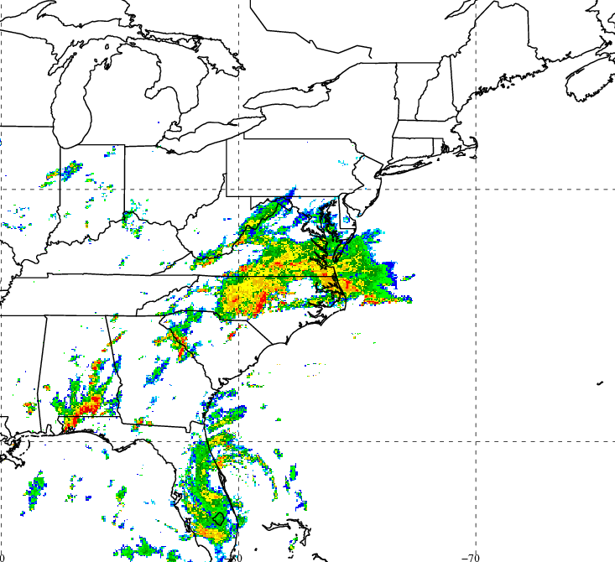
Cross-section view of the mature PRE
0000 UTC 31 Aug
1º GFS
Analysis
Tangential circulation vectors, θ (K, gray contours),
frontogenesis [K (100 km)⁻¹ (3 h)⁻¹, red shading],
mixing ratio (g kg⁻¹, gray shading), wind speed (≥ 20 m s−1, blue contours)

Slide 28
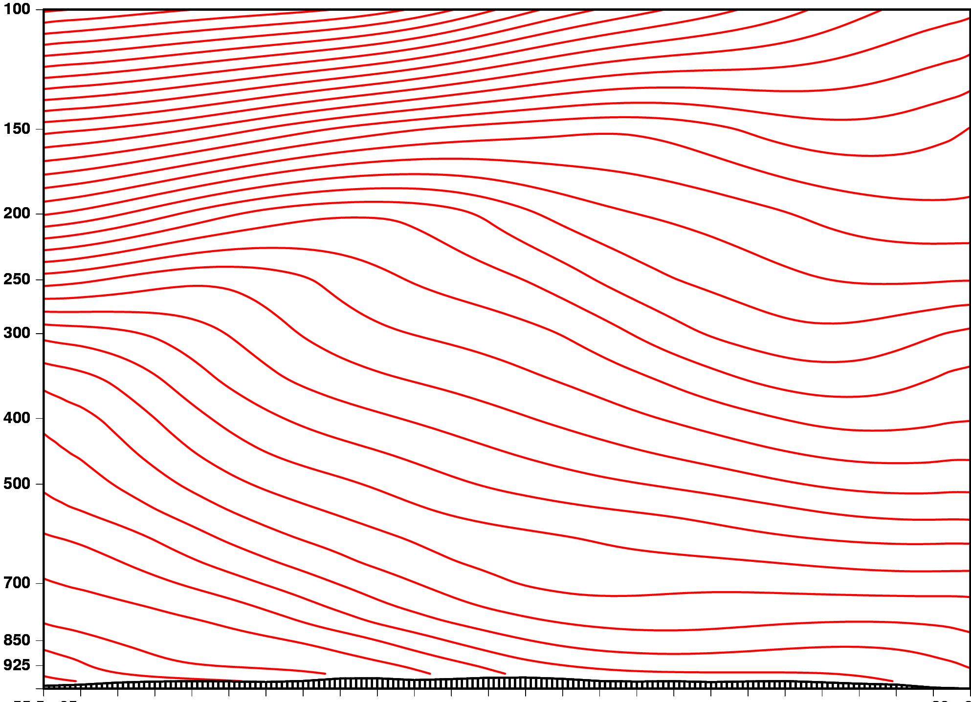
Schematic Depiction a PRE
Pressure (hPa)
J
F
Latent Heat
Release
F
Moist low-level flow
N
S
1000 km

Slide 29
Concluding Remarks
Key features of composites
PREs preferentially develop in equatorward entrance region of an upper-level jet streak
Strong low-level flow downstream of TC oriented perpendicular to baroclinic zone → warm air advection, frontogenesis, moisture transport from the TC
Categories differ with regard to:
Position of TC relative to key features (i.e., trough, jet, ridge, baroclinic zone)
Amplitude and configuration of upper-/middle-tropospheric flow
Degree of the interaction between the TC and the midlatitude flow

Slide 30
Concluding Remarks
Ernesto case summary
Convection initially developed along a surface thermal boundary within the equatorward entrance region of a 200-hPa jet streak
The PRE intensified due to a combination of:
Enhanced lift of southerly flow over a thermal boundary associated with an evaporation-induced cold pool
Deep moisture flux from the TC
Diabatically-generated divergent outflow from the PRE acted to strengthen upper-tropospheric PV gradients and intensify the jet streak

Slide 31
Concluding Remarks
Ernesto case summary
Diabatic ridging associated with Ernesto favored weak, southerly steering flow, allowing it to track along the East Coast
An antecedent thermal boundary associated with the PRE-induced cold pool served as a focus for heavy rain as Ernesto moved over the PRE region

